Slide 1
Relating & Communicating
Addressing Generational Diversity in the Classroom

Slide 2
How Do we Relate?
TOPICS:
Explore the uniqueness of each of the
four generations at the college today.
Discuss how to best communicate with and meet expectations of each
generation
Build on the best that all four generations bring to our worlds

Slide 3
Generations Clash
Shift of leadership paradigm
Challenges facing colleges to attract and retain employees & students
Pace of global change
Current success

Slide 4
Generation 101
Demographics: the ebb and flow of birth rates
What shapes us:
Our culture
Our personal life events
The generation in which we are born
Our formative and coming of age years
Common sense making of economic factors,
Heroes, villains, world events and politics
Topic of diversity

Slide 5
“People resemble their times and their peers more than they resemble their parents.”
Alan Foote

Slide 6
Northern College
Traditionalists
Born 1932-1945
Baby Boomers
Born 1946 - 1964
Generation X
Born 1965 - 1979
Millennials
Born 1980 – 1998

Slide 8
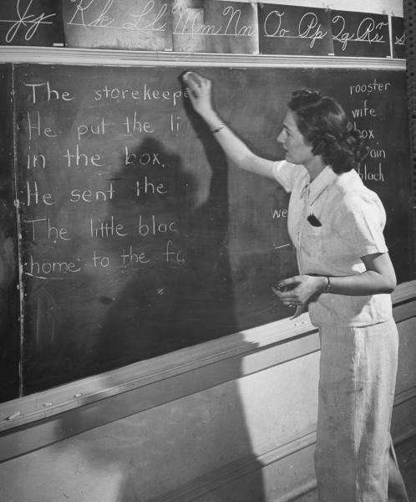
Traditionalists

Slide 9
Work First Career = Opportunity
Comfortable with command and control leadership
Work and family are kept separate
Advancement based on tenure ladder
Like consistency and uniformity
Future should be extension of the past

Slide 10
What Others are Saying…
Baby Boomers Say: They…. | Gen Xers Say: They …. | Millennials Say: They…
are dictatorial | are too set in their ways | are trustworthy
are rigid, they need to adapt better to change | learn how to use your email | are good leaders
are inhibited/narrow minded | have all the money | are brave

Slide 11
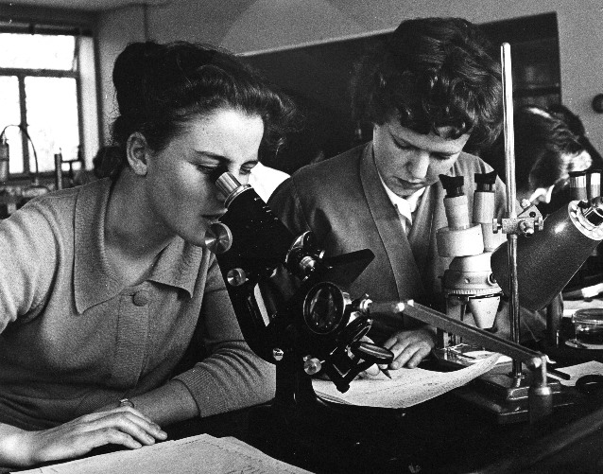
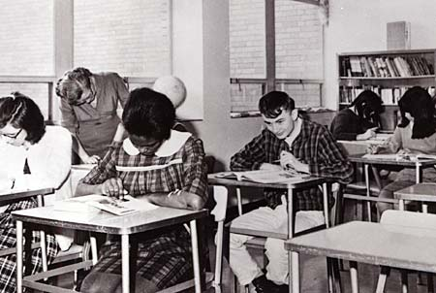
Baby Boomers

Slide 12
Live to Work Career = Self Worth
Participative management
Loyalty to the team
“I am my job.”
Politically connected at work
Challenge the rules
Push to change everything
Process over results
Hesitant to engage in conflict

Slide 13
What Others are Saying…
Traditionalists Say: They…. | Gen Xers Say: They …. | Millennials Say: They…
talk about things they ought to keep private… | are self righteous, workaholics | are cool, they are up to date on the music we like
are self absorbed | are too political, | work too much
 | do a great job of talking the talk
 | lighten up, it’s only a job

Slide 14
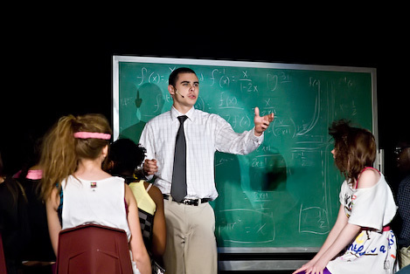
Generation X

Slide 15
Work to Live Career = One Part of Me
Loyal to good leadership, frustrated by office politics
Promotions based on results and expertise
Get to the point communication style
Old rules can get in the way
Work independently with virtual connections
Results are everything (24/7 for projects)
Competency driven

Slide 16
What Others are Saying…
Traditionalists Say: They…. | Baby Boomers Say: They …. | Millennials Say: They…
don’t respect experience | are slackers | need to cheer up, you are way too serious
don’t follow proper procedures | are rude & lack social skills
don’t know what hard work is | are always doing things their own way spend too much time on the internet & email
 | do not wait their turn

Slide 17
Millennials

Slide 18
Live then Work Career = Add Value
Loyal to their group
Casual relationship to work
Challenged by constructive feedback
Take multitasking to a new level
Fun and flexibility are key
Expect constant connection
Open access to information

Slide 19
What Others are Saying…
Traditionalists Say: They…. | Baby Boomers Say: They …. | Xer’sSay: They…
have good manners | are cute | are another self absorbed generation
are smart little critters | need more discipline from their parents | what do you mean, “what’s an album?”
need to toughen up | can set the time on the DVD player & program my iPod
watch way too much t.v. | need to entertain themselves

Slide 20
Break into groups according to generation…
Please break into your respective generational groupings!
Without Discussion please write down 3 major events that happened in society when you were 10 years old.
Can be national or international
And compare with your group

Slide 21
Comparing Events…
Notes:
Would each generation from every site please share one major event starting with porcupine…

Slide 22
Traditionalists 1932-1945
Major Events
Depression years
World War II
Korean War
Rise of labor unions
The New Deal
Characteristics
Strong work ethic
Respect authority
Economic conservatism
Long term focus, stable
Trust in the institution

Slide 23
Baby Boomers 1946-1964
Major Events
Cold War and Vietnam
Landing on the Moon
Social unrest
Political assassinations
Characteristics
Optimism and expansion
Drive to succeed, competitive
Personal growth and
gratification
Relationship and team focus
Involvement
Eager to make a difference

Slide 24
Gen X 1965-1978
Major Events
Massive corporate layoffs
Shifting family dynamics
Exxon Valdez Oil Spill
Challenger Disaster
Operation Desert Storm
Iran Hostage of Americans
Personal computers
Characteristics
Independent and self reliant
Pragmatic and skeptical
Flexible and adaptable
Entrepreneurial free lancers
Authority based on expertise

Slide 25
Millennials 1979-1989
Major Events
Economic Boom late 1990s
Wired, digital age
Protective, dedicated parents
Multi-faceted childhoods
Increased neighborhood violence
Characteristics
Confident and optimistic
Global perspective
Strong sense of morality
Equality for everyone
Strong bonds with peers
Casual relationship with authority

Slide 26
Strengths of Each
 | Traditionalists | Boomers | Xer’s | Gen Y
Strategy | Acceptance | Visionary | Applicability | Support
Change | Follow Requests | Ideas | Project Excellence | Participation
Transition | Storytelling | Bringing Everyone Along | Creativity | Willingness
Communication | Listen | Involvement | Act On | Learn

Slide 27
Group Thought Provokers…
What concerns you most about the other
generations?
What do you admire most about the other generations?
What bothers you about your own generation?
What legacy would you like your generation to leave?
What is one action you will do in regards to bridging the generation gap at the college?
Notes:
As we can see each group brings a strengths, we take a look at all of these positive words pertaining to the workplace and we see that every generation brings to the table its on unique and valuable strength. We’re luck to have all four generations at the college, it provides a diverse and unique skill set to draw from.

Slide 28
Let’s share the last question
What is one action you will do in regards to bridging the generation gap at the college?
Let’s start with the traditionalists at each campus and work down from there…

Slide 29
http://www.youtube.com/watch?v=dGCJ46vyR9o&feature=player_embedded

